Slide 1
Introduction to Robotics
CSE 461
Class Topic: Introduction to Control System Theory (PID)
Brac University

Slide 2
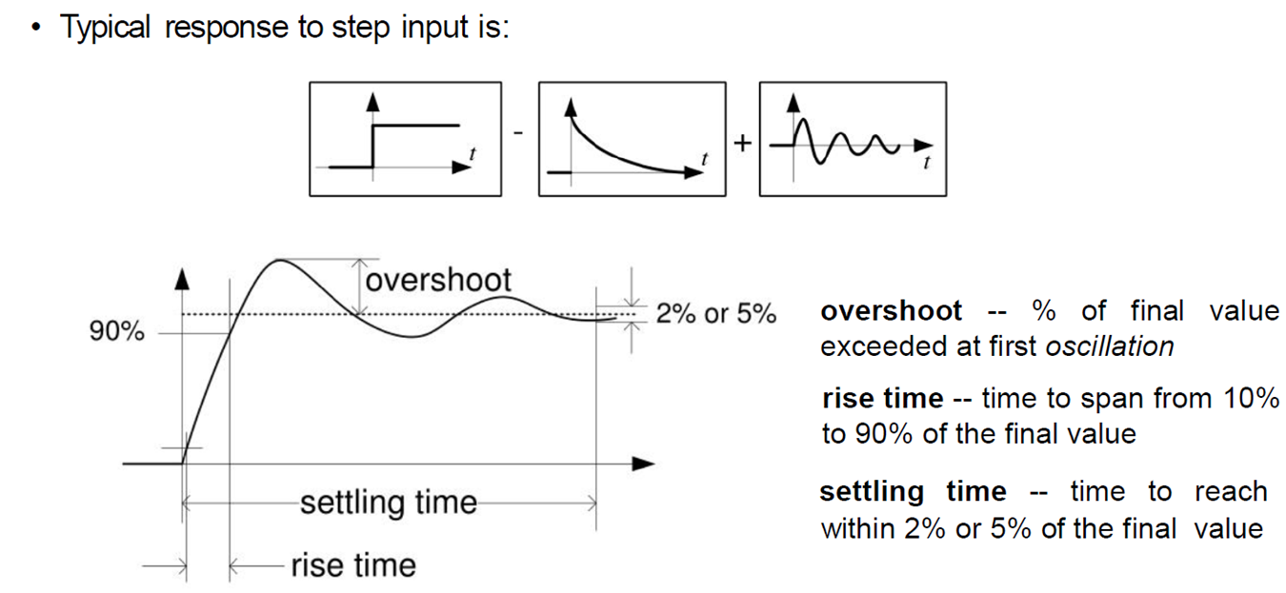
2nd order control system

Slide 3
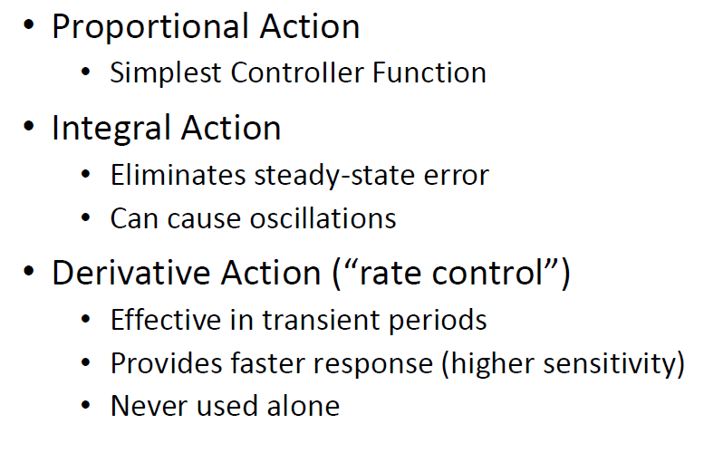
Effect of PID controller function

Slide 4
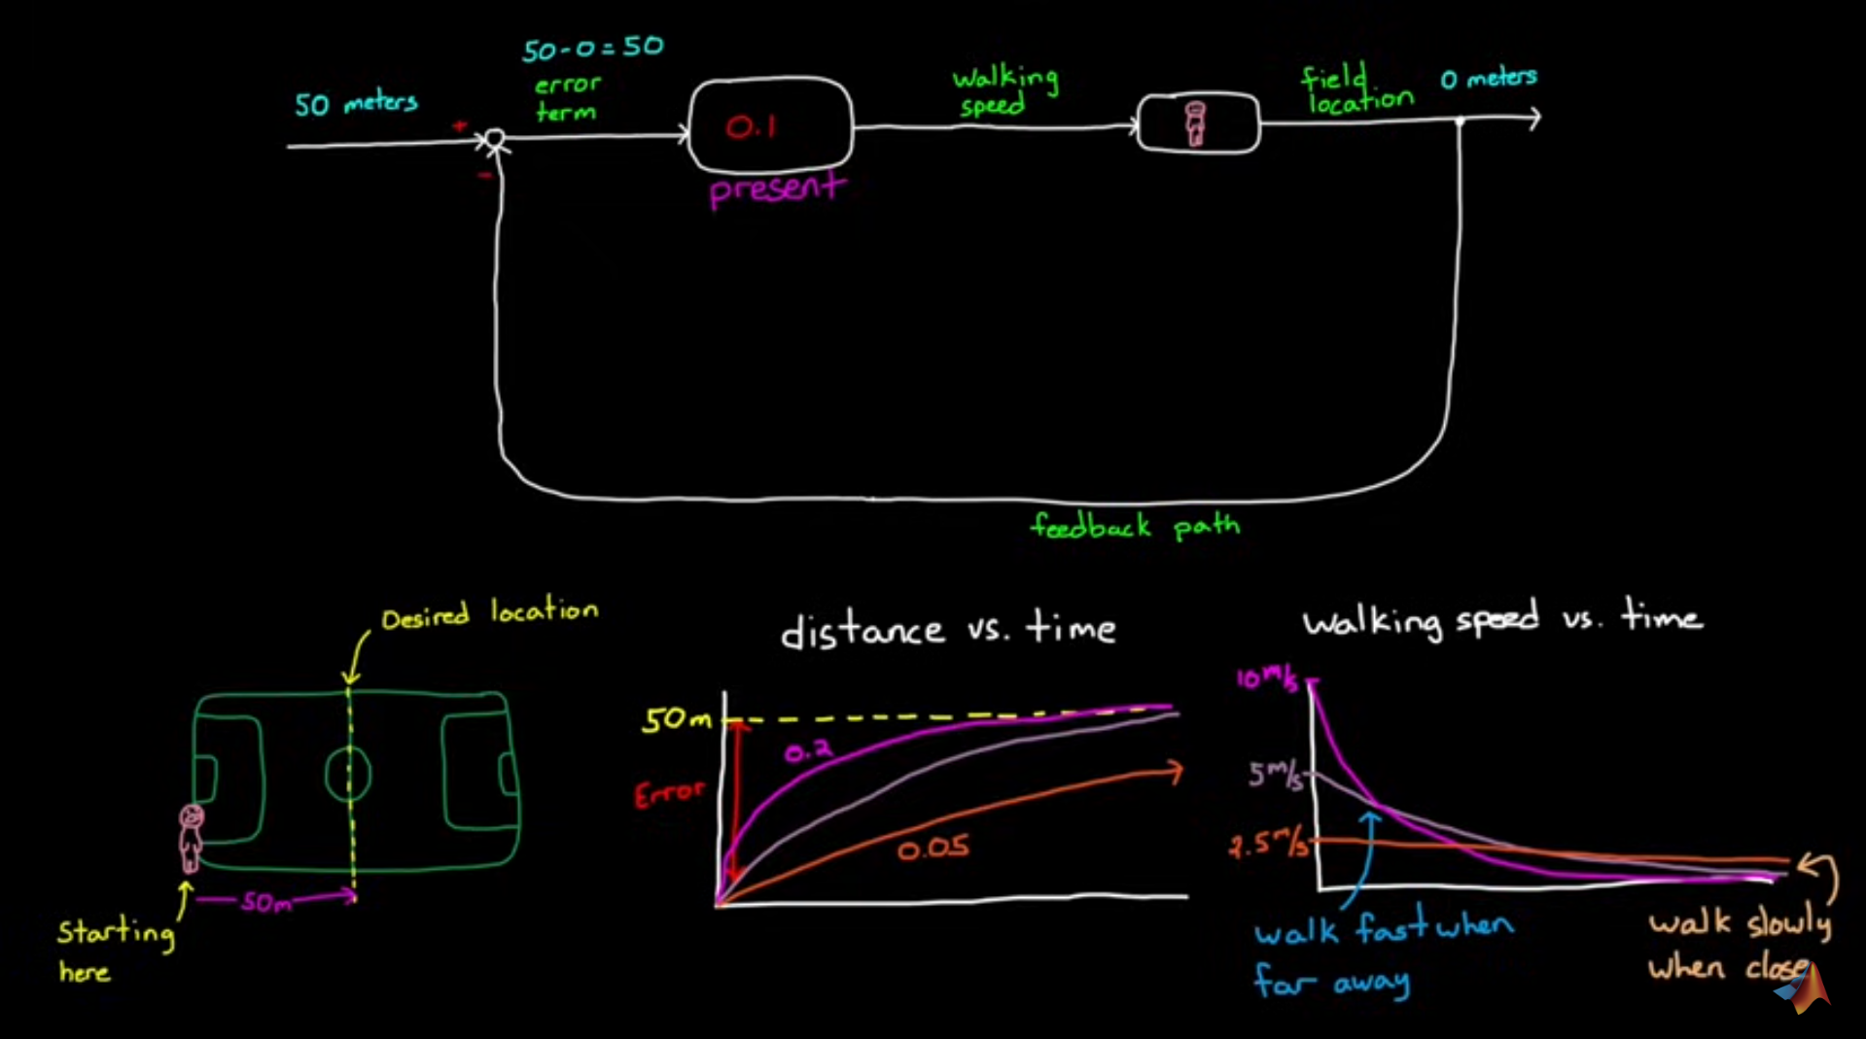
Proportional works with football field

Slide 5
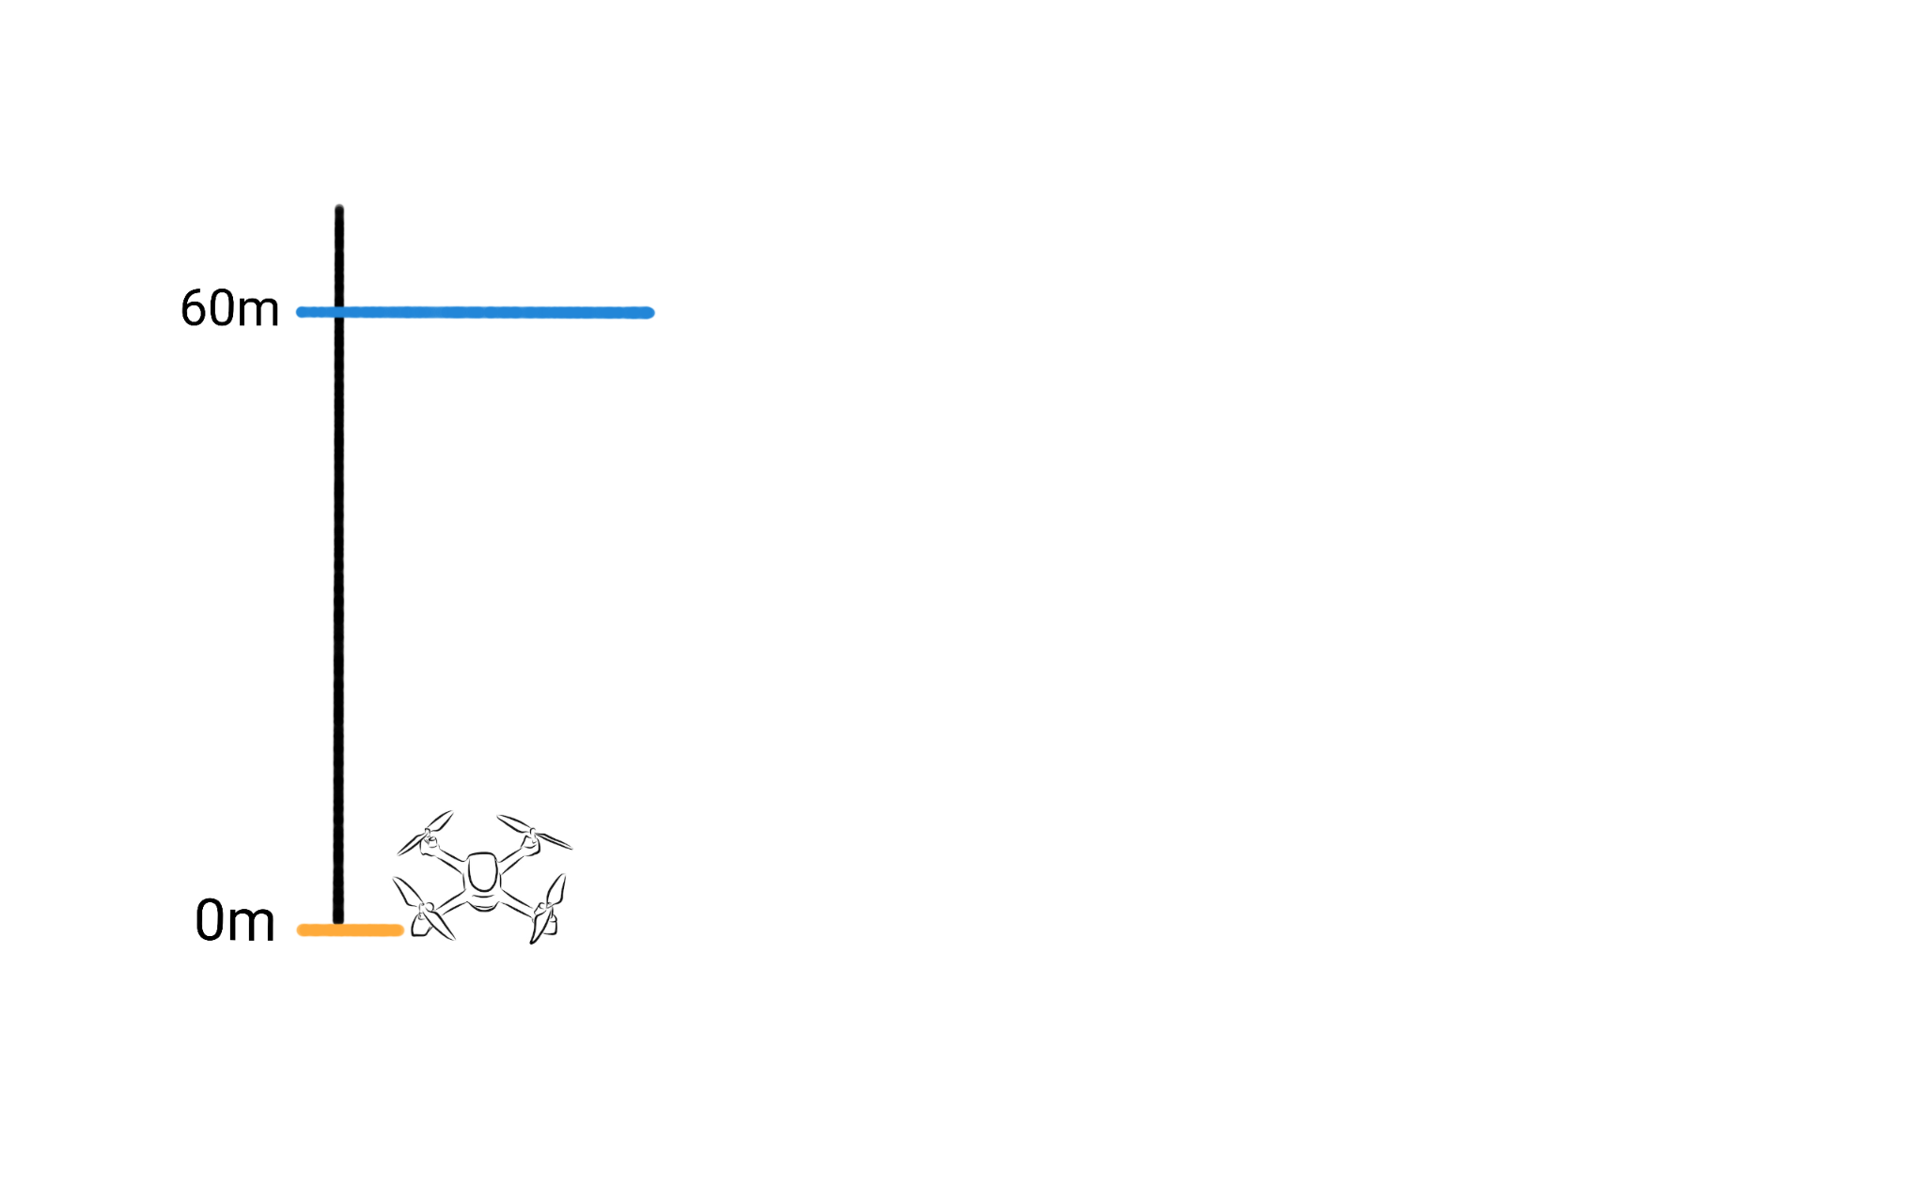

Slide 6
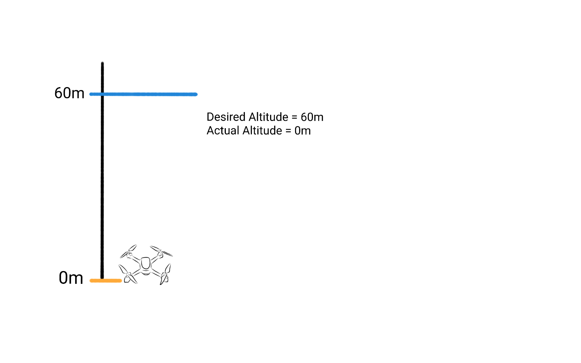

Slide 7
Desired Altitude - Actual Altitude
= 60m - 0m
= 60

Slide 8
Desired Altitude - Actual Altitude
= 60m - 0m
= 60
= Error

Slide 9
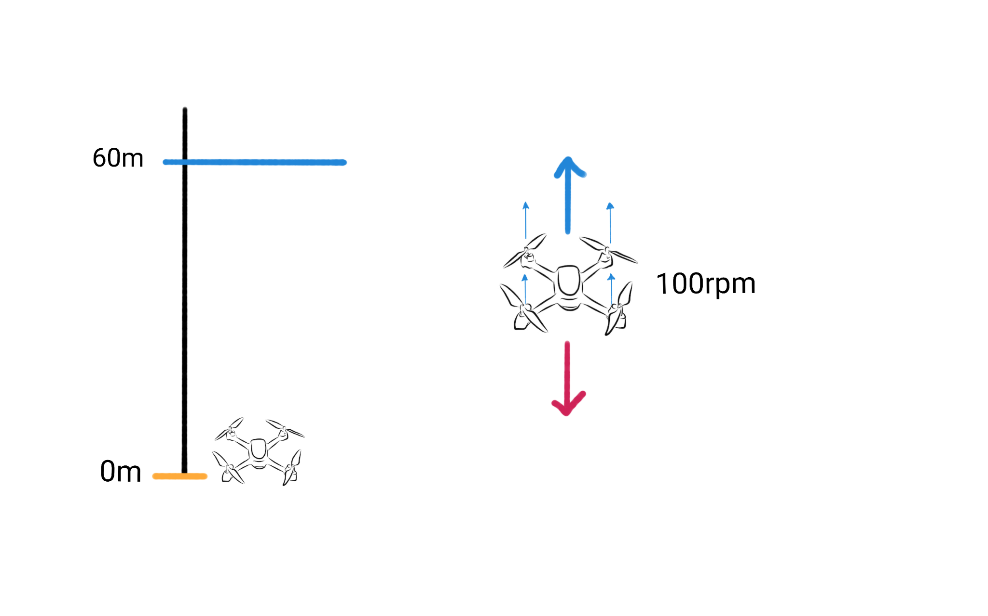

Slide 10
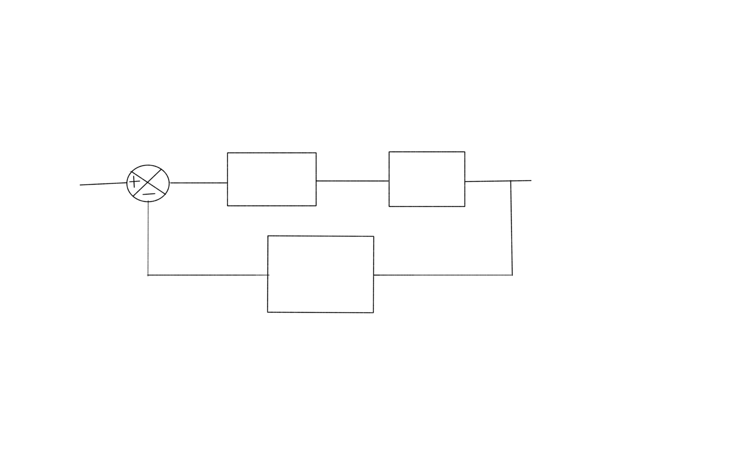
Desired Altitude
Gain
Propeller
Actual Altitude
Altitude Measuring Sensor

Slide 11
Desired Altitude
1
Propeller
Actual Altitude
Altitude Measuring Sensor

Slide 12
Desired Altitude
1
Propeller
Actual Altitude
Altitude Measuring Sensor
Desired Altitude - Actual Altitude
= 60m - 0m
= 60
Propeller Speed = 60 * 1 = 60 rpm

Slide 13
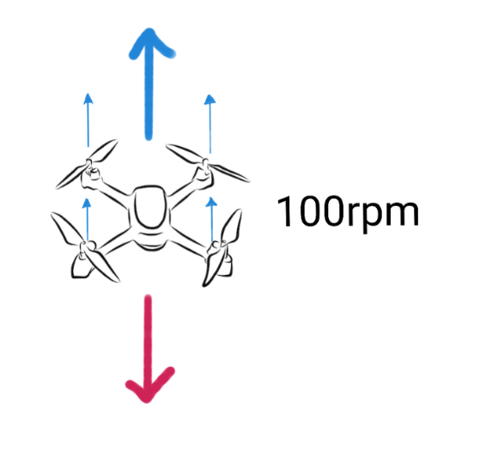
Desired Altitude
1
Propeller
Actual Altitude
Altitude Measuring Sensor
Desired Altitude - Actual Altitude
= 60m - 0m
= 60
Propeller Speed = 60 * 1 = 60 rpm

Slide 14
Desired Altitude
2
Propeller
Actual Altitude
Altitude Measuring Sensor

Slide 15
Desired Altitude
2
Propeller
Actual Altitude
Altitude Measuring Sensor
Desired Altitude - Actual Altitude
= 60m - 0m
= 60
Propeller Speed = 60 * 2 = 120 rpm

Slide 16
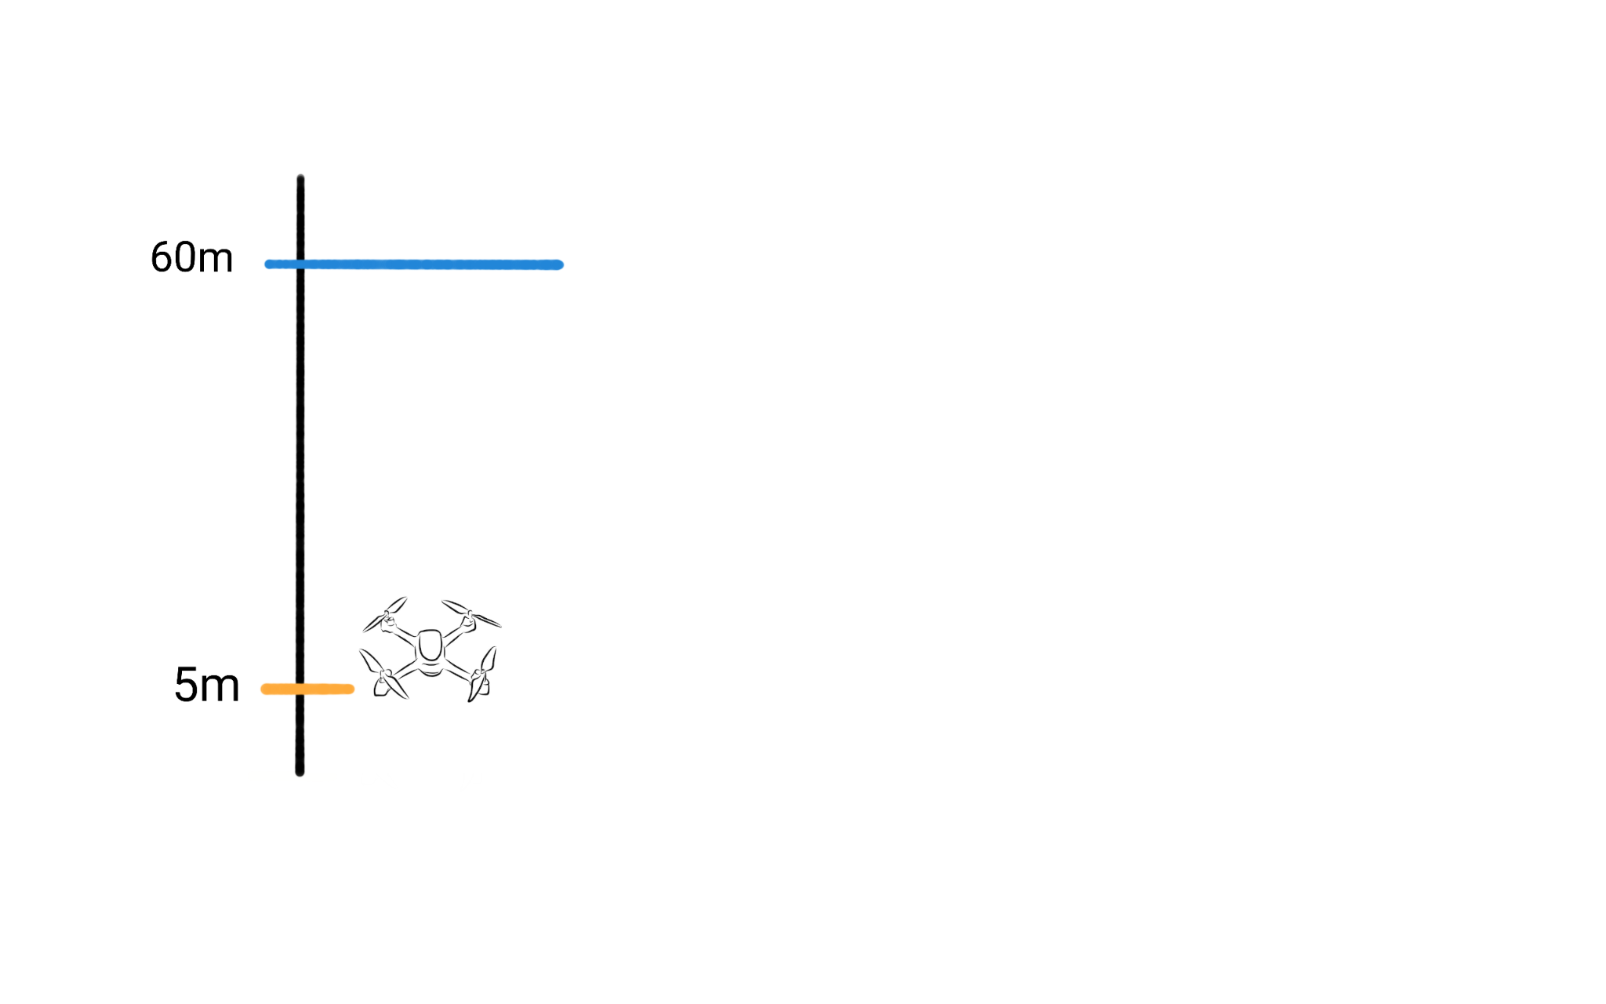
Desired Altitude
2
Propeller
Actual Altitude
Altitude Measuring Sensor
Desired Altitude - Actual Altitude
= 60m - 5m
= 55
Propeller Speed = 55 * 2 = 110 rpm

Slide 17
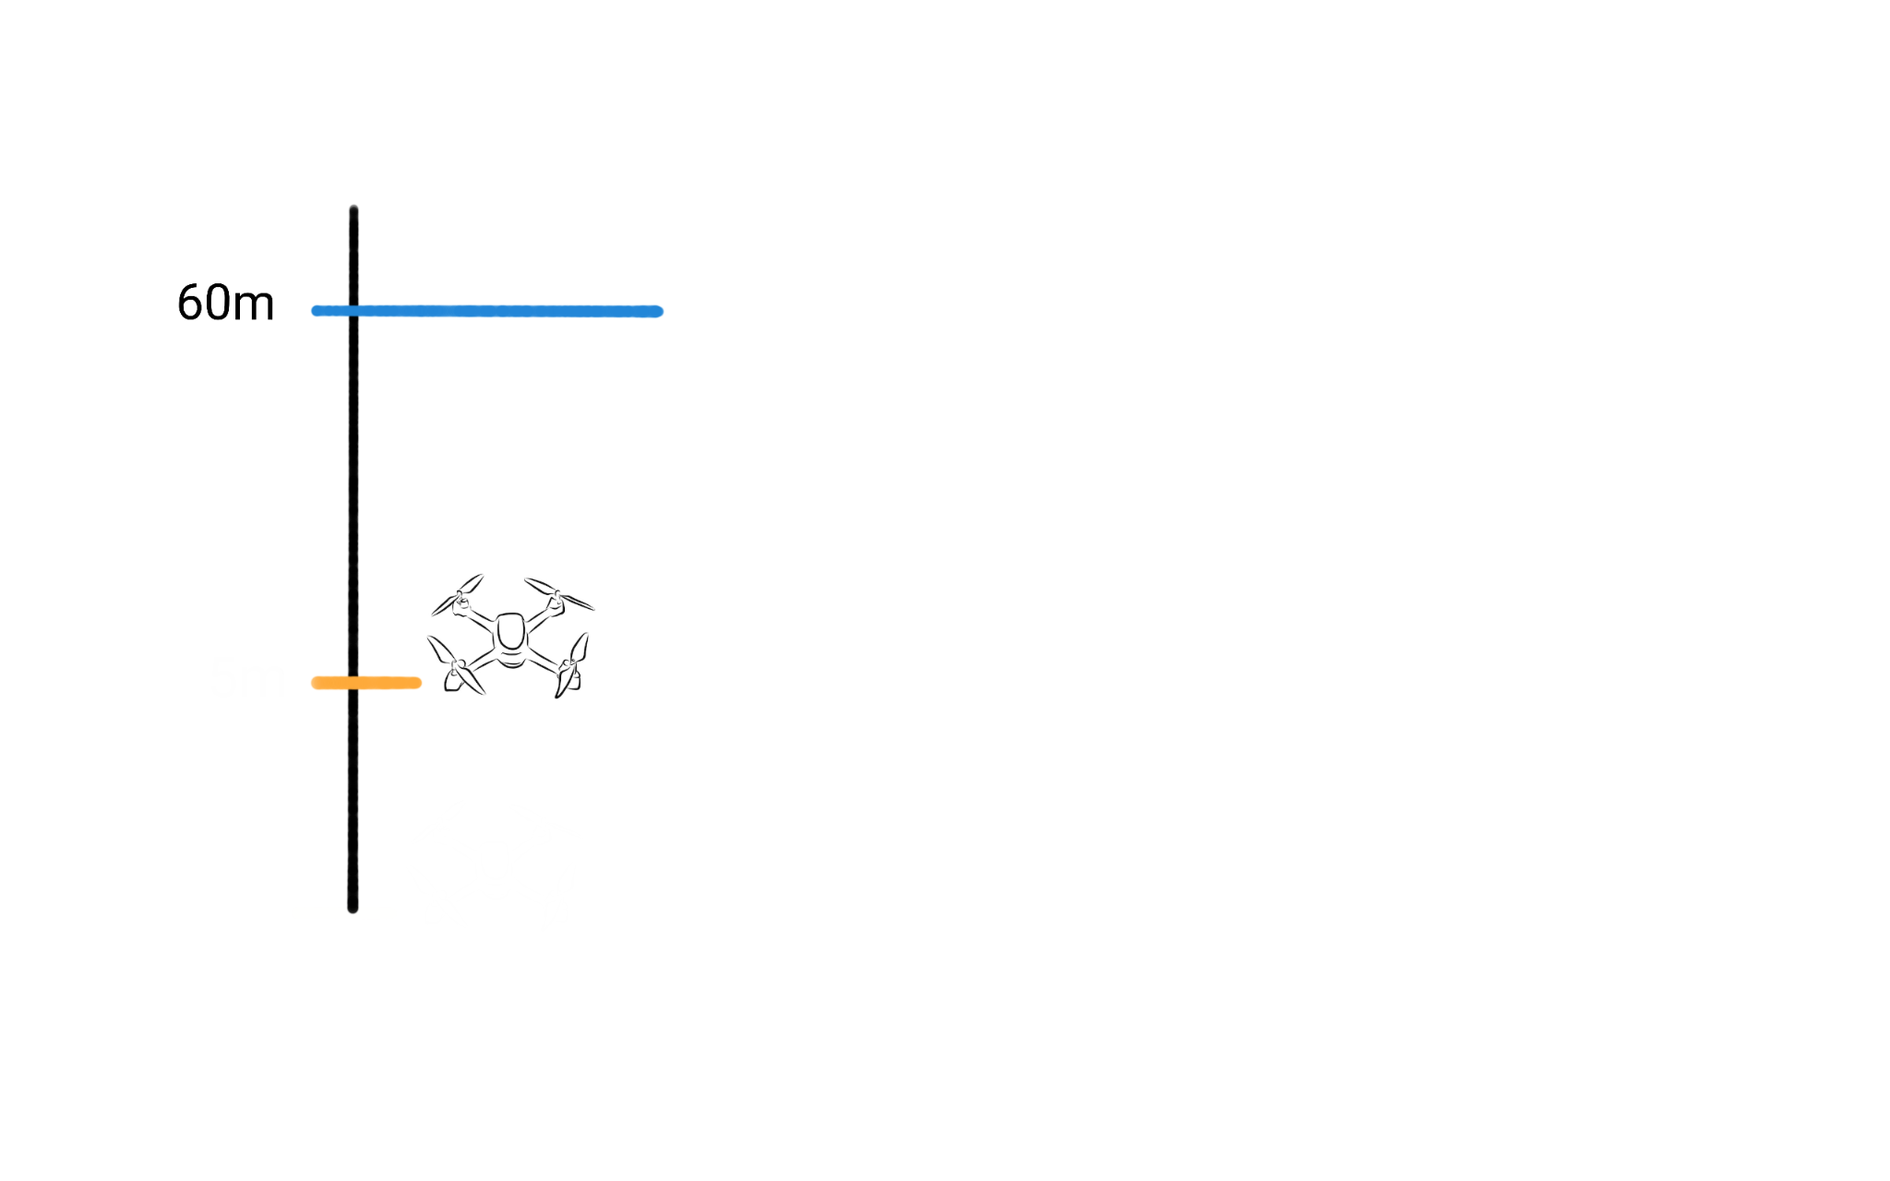
Desired Altitude
2
Propeller
Actual Altitude
Altitude Measuring Sensor
Desired Altitude - Actual Altitude
= 60m - 10m
= 50
Propeller Speed = 50 * 2 = 100 rpm
10m

Slide 18
Desired Altitude
2
Propeller
Actual Altitude
Altitude Measuring Sensor
Desired Altitude - Actual Altitude
= 60m – 10.1111m
= 49.9999
Propeller Speed = 49.99 * 2 = 99.99 rpm
10m

Slide 19
Desired Altitude
10
Propeller
Actual Altitude
Altitude Measuring Sensor
Desired Altitude - Actual Altitude
= 60m - 10m
= 50
Propeller Speed = 50 * 10 = 500 rpm
10m

Slide 20
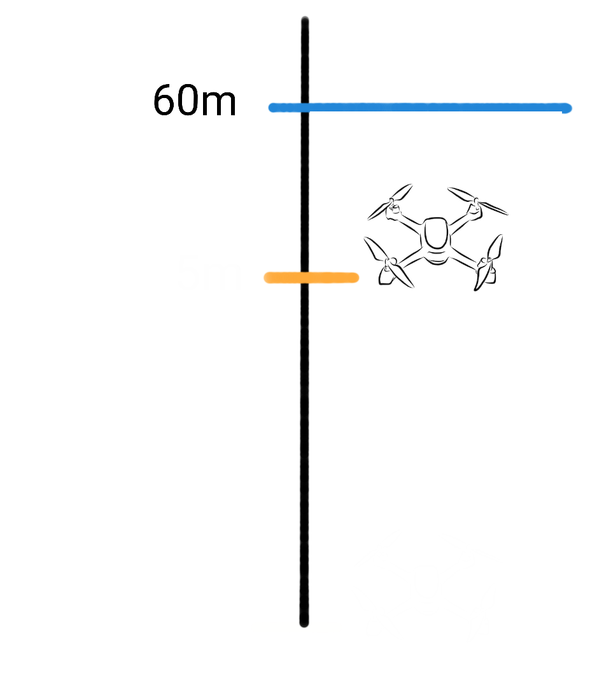
Desired Altitude
10
Propeller
Actual Altitude
Altitude Measuring Sensor
Desired Altitude - Actual Altitude
= 60m - 50m
= 10
Propeller Speed = 10 * 10 = 100 rpm
50m

Slide 21
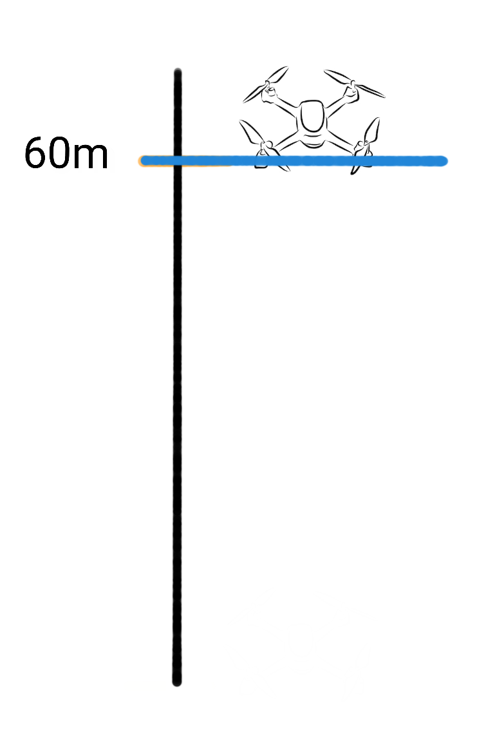
Desired Altitude
10
Propeller
Actual Altitude
Altitude Measuring Sensor
Desired Altitude - Actual Altitude
= 60m - 60m
= 0
Propeller Speed = 0 * 10 = 0 rpm

Slide 22
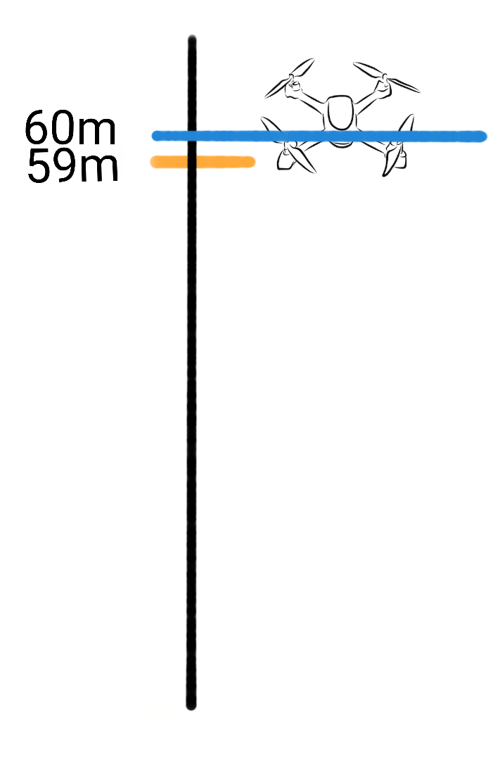
Desired Altitude
100
Propeller
Actual Altitude
Altitude Measuring Sensor
Desired Altitude - Actual Altitude
= 60m - 59m
= 1
Propeller Speed = 1 *100 = 100 rpm

Slide 23
Desired Altitude
10
Propeller
Actual Altitude
Altitude Measuring Sensor
Desired Altitude - Actual Altitude
= 60m – 59.1m
= .9
Propeller Speed = .9 * 10 = 90 rpm

Slide 24
Desired Altitude
10
Propeller
Actual Altitude
Altitude Measuring Sensor
Propeller Speed = 10 * 10 = 100 rpm
Error = 10
50m
Output = Kp * error

Slide 25
Desired Altitude
10
Propeller
Actual Altitude
Altitude Measuring Sensor
Propeller Speed = 10 * 10 = 100 rpm
Error = 10
50m
Output = Kp * error
Proportional Control

Slide 26
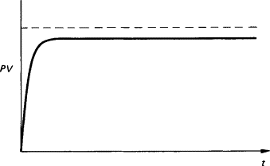
Proportional Control
Steady-State error

Slide 27
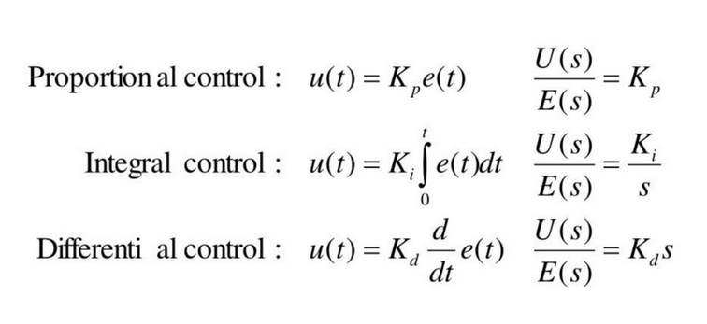
PID Controller

Slide 28
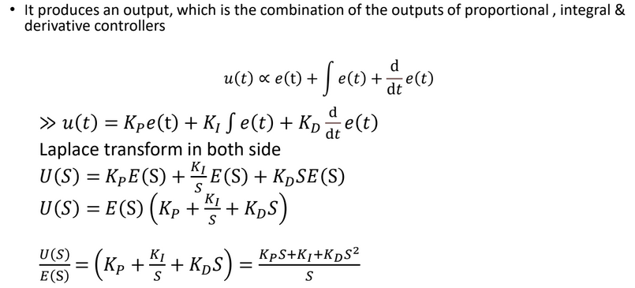

Slide 29
Desired Altitude
Ki*e + Kp * ∫e
Propeller
Actual Altitude
Altitude Measuring Sensor
Propeller Speed = 10 * 10 = 100 rpm
Error = 10
50m

Slide 30
Desired Altitude
Ki*e + Kp * ∫e
Propeller
Actual Altitude
Altitude Measuring Sensor
Propeller Speed = 10 * 10 = 100 rpm
Error = 10
50m
Output = Kp * error + Ki * (error1 + error2 +…+ errorN(0))
Proportional - Integral Control

Slide 31
Desired Altitude
Kp*e + Ki * ∫e
Propeller
Actual Altitude
Altitude Measuring Sensor
Propeller Speed = 10 * 10 = 100 rpm
Error = 10
50m
Output = Kp * error + Ki * (error1 + error2 + … +errorn (0))
Output1= 10*60+5*60=900
Output2= 10*50+5(60+50)=1050
Output3= 10*40+5(60+50+40)=1150
Output4= 10*30+5(60+50+40+30)=1200
Output5= 10*20+5(60+50+40+30+20)=1200
Output6= 10*10+5(60+50+40+30+20+10)=1150
Output7= 10*0+5(60+50+40+30+20+10+0)=1050

Slide 32
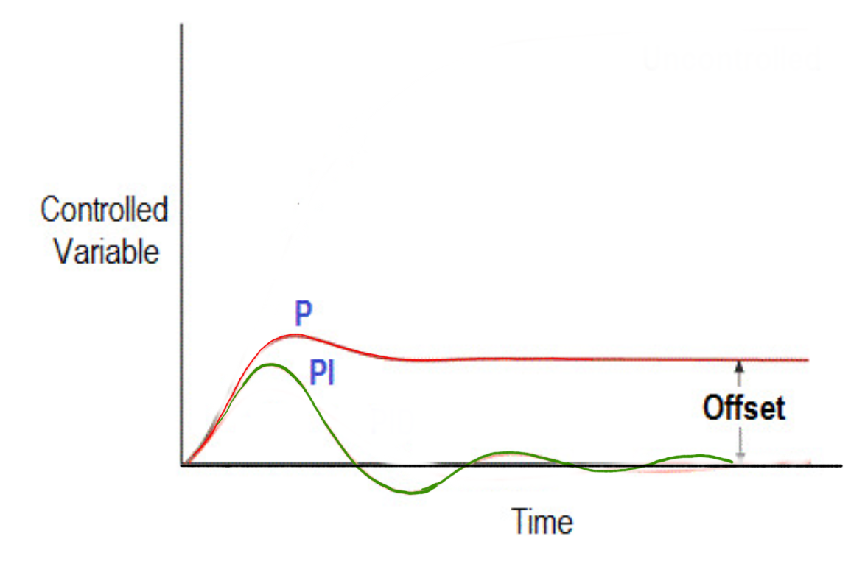
Desired Altitude
Ki*e + Kp * ∫e
Propeller
Actual Altitude
Altitude Measuring Sensor
50m

Slide 33
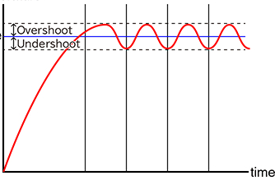
Proportional Control

Slide 34
Ki*e +
Kp * ∫e + Kd * ∇ e
Actual Altitude
Desired Altitude
Propeller
Altitude Measuring Sensor
Propeller Speed = 10 * 10 = 100 rpm
Error = 10
50m
Output = Kp * error + Ki * (error1 + error2 + error3) + Kd * ( error3- error 2)

Slide 35
Ki*e +
Kp * ∫e + Kd * ∇ e
Actual Altitude
Desired Altitude
Propeller
Altitude Measuring Sensor
Propeller Speed = 10 * 10 = 100 rpm
Error = 10
50m
Output = Kp * error + Ki * (error1 + error2 + error3) + Kd * ( error3- error 2)
Proportional - Derivative - Integral Control
(PID) Control

Slide 36
Ki*e +
Kp * ∫e + Kd * ∇ e
Actual Altitude
Desired Altitude
Propeller
Altitude Measuring Sensor
Propeller Speed = 10 * 10 = 100 rpm
Error = 10
50m
Output = Kp * error + Ki * (error1 + error2 + error3) + Kd * ( error3- error 2)
Output1= 10*60+5*60+.5*60=930
Output2= 10*50+5(60+50) +.5*(60-50)=1055
Output3= 10*40+5(60+50+40) + .5*(50-40)=1155
Output4= 10*30+5(60+50+40+30) + .5*(40-30)=1205
Output5= 10*20+5(60+50+40+30+20) + .5*(30-20)=1205
Output6= 10*10+5(60+50+40+30+20+10) + .5*(20-10)=1155
Output7= 10*0+5(60+50+40+30+20+10+0) + .5*(10-0)=1055

Slide 37
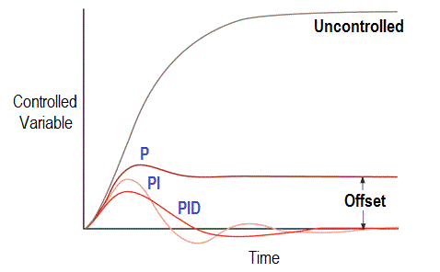
Proportional - Derivative - Integral Control
(PID) Control

Slide 38
Effect of Controller Functions
• Proportional Action
Simplest Controller Function, The P term helps to reduce the steady-state error and improve the system's responsiveness. However, too high of a proportional gain can lead to instability and oscillations in the system's response.
• Integral Action
Eliminates steady-state error, The I term helps to improve the system's stability and eliminate any bias in the system. However, too high of an integral gain can lead to overshoot and instability in the system's response.
• Derivative Action (“rate control”)
Effective in transient periods, The D term helps to improve the system's stability and reduce the effects of disturbances in the system. However, too high of a derivative gain can lead to noise amplification and instability in the system's response.

Slide 39
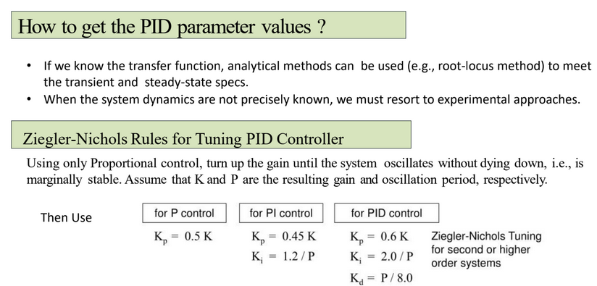

Slide 40
Generating PID parameters
Auto-Tuning Algorithms:
Relay-based Auto-Tuning
A relay is introduced in the control loop.
Observes the system's oscillatory response.
Calculates PID parameters based on oscillation characteristics.
Trial and Error: Iteratively adjust parameters based on system response.

Slide 41
Advantages and Applications of PID control
Advantages:
Simple: easy to understand.
Effective: Accurate and stable, even in dynamic environments.
Robust: Can be adopted to different robot systems
Application:
Arm positioning
Robot Navigation
Speed Control
Balance control

Slide 42
Next Class
Machine Learning

